Slide 1
CS 4530: Fundamentals of Software Engineering Module 5, Lesson 5 Testing Web Applications
Rob Simmons
Khoury College of Computer Sciences

Slide 2

Software interacts with an environment
Tests replace user interaction
Network, Time, Randomness
The SUT
Mo
Human User
Lies!!!
Database
2
Notes:
Actual users don’t interact with our web application according to the API layer, they interact with our application through the browser

Slide 3
Mock System-Level Components with Capture/Replay
Record the API requests and responses that clients make
Test new versions of the API by identifying requests that result in different responses ("breaking changes")
Current version of API
Clients (created by many third parties)
Capture/Replay Proxy for Testing
Production traffic
Production traffic
Next version of API
Replay production traffic for testing
https://www.tradeweb.com/our-markets/data--reporting/replay-service/
Notes:
Capture/replay can also be used as a testing strategy when building large, complex APIs. Consider the case where we are building (your favorite API…stripe/shopify/twilio/linkedin/Facebook/whatever). We do our best to specify clearly what clients should expect of our API. However, it is surely impossible to specify all possible behaviors, and clients may rely on invalid assumptions about our specification.
Hence, it’s often extremely important, as the developer of that API, to test for and detect breaking changes before making a release. If your biggest clients are going to have a problem using the new version of your API, you should probably detect this and let them know, before they are the ones who figure it out.
With this approach, we create, effectively, a mock for all (or some) of our clients by capturing all of the requests and responses. We can then replay that API traffic against the new version of our API under development to detect breaking changes.
Of course, replaying API traffic might have some side-effects, too (imagine replaying the traffic of a payment processor, and in doing so making duplicate payments!). Doing this well requires a complex testing environment, where we might also have other mocks that isolate this testing environment from all of the production services.
Example: TradeWeb ReplayService™: a testing platform for financial market data applications
Originally a product of Thomson Reuters (data provider), then spun off to CodeStreet, then acquired by TradeWeb https://www.tradeweb.com/our-markets/data--reporting/replay-service/

Slide 4
Acceptance Tests can be formulated as scenarios
Acceptance tests are written to verify behavior from a user’s perspective.
The focus is on treating the application as a black-box
Tests may be specified as given-when-then scenarios:
given there's a logged in user and there's an article "bicycle" when the user navigates to the "bicycle" article's detail page and clicks the "add to basket" button then the article "bicycle" should be in their shopping basket
https://docs.cypress.io/guides/end-to-end-testing/writing-your-first-end-to-end-test
Notes:
<read slide>

Slide 5
Deployed systems create testing challenges
Clients believe “how it is now is right”,
Not “how the API intended it to be is right”
Writing thorough test suite is even harder, less useful
What is a “breaking change”?
Still: vital to detect breaking changes
Examples:
Detailed layout of GUIs
Side-effects of APIs, particularly under corner-cases
Notes:
Testing larger systems may get more complicated. How do you automatically check for breaking changes and updates to GUI layout?
<Read slide>
If we move a button, is that a breaking change? Do our clients rely on the *exact* position of that button?

Slide 6
But how to make these human-readable scenarios into executable tests?
Scenarios like the one above are readable by humans (e.g. customers)

Slide 7
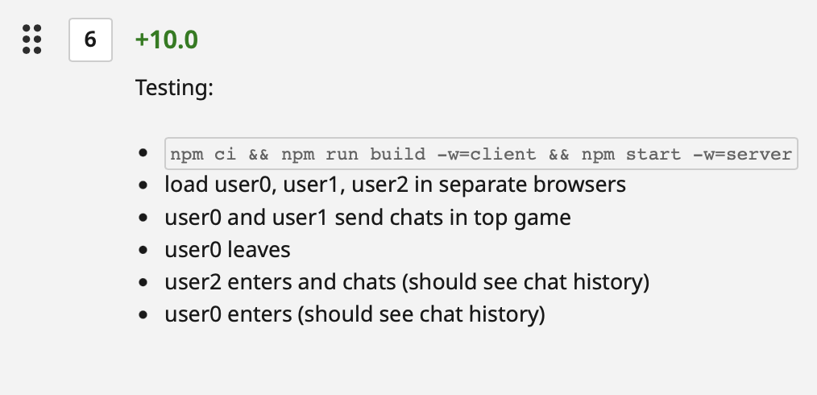
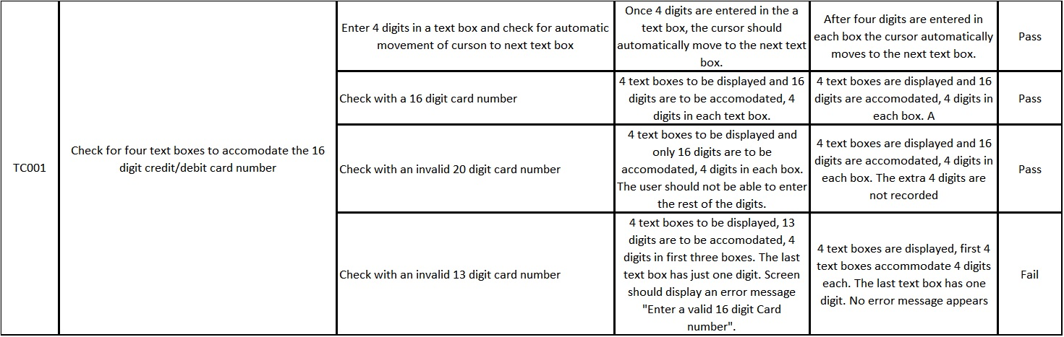
But how to make these human-readable scenarios into executable tests?
Automation is a spectrum — humans can automate tests!
Many of the same concerns apply: deterministic, not flaky…
https://www.browserstack.com/guide/test-case-vs-test-script

Slide 8
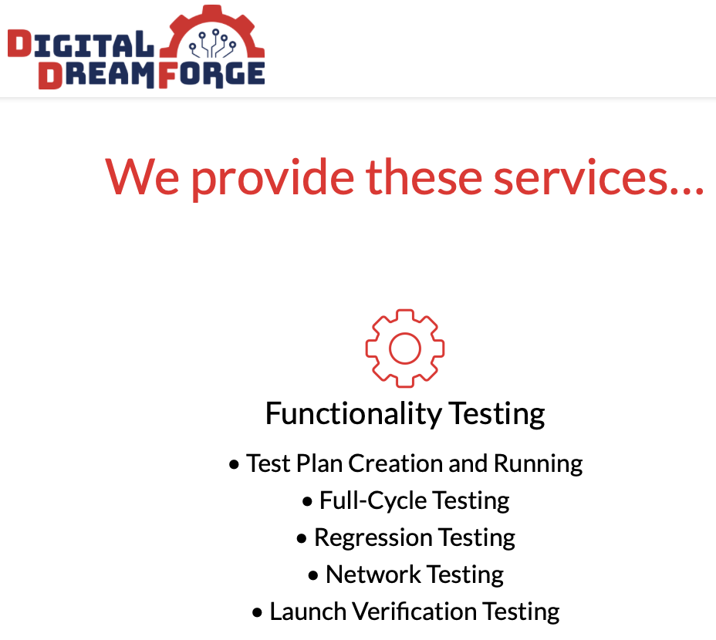
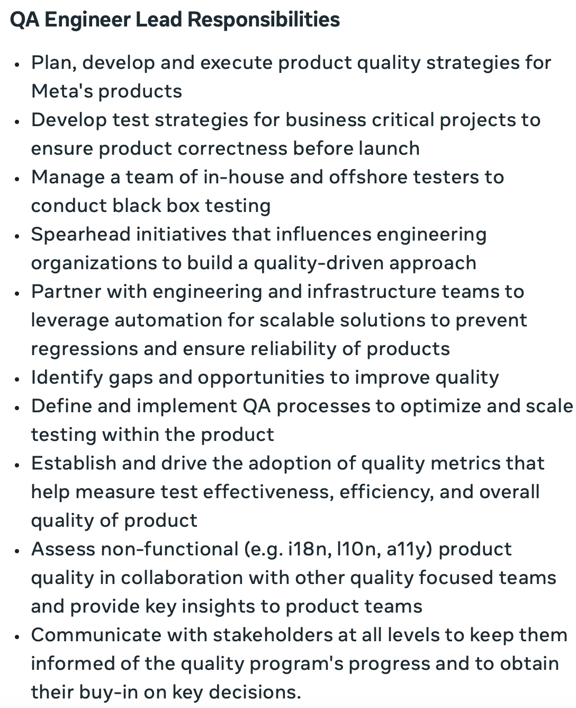
But how to make these human-readable scenarios into executable tests?
Entire companies specialize in this endeavor (https://www.digitaldreamforge.com/our-services/)
Entire sub-specialization within software engineering to push automation faster/simpler/more reliable to meet agile & CI/CD goals
Notes:
There’s an

Slide 9
But how to make these human-readable scenarios into executable tests?
They are not automatable are not automatable
Lots of tools to fill the gap: I’ll add links to the lesson page

Slide 10
Snapshot Tests Can Detect GUI Changes
The first time the test runs, it saves a "snapshot" of the rendered GUI
Subsequent runs will fail if the snapshot changes
import renderer from 'react-test-renderer';
import Link from '../Link';
it('renders correctly', () => {
const tree = renderer
.create(<Link page="http://www.facebook.com">Facebook</Link>)
.toJSON();
expect(tree).toMatchSnapshot();
});
Notes:
<Maybe just read text of slide>
(Read slide. Code on left is the test, on right is what happens after running the test to save the snapshot, then changing Facebook to instagram)
This test might have a "false positive" in that it will fail for any change, and not just a bug. However, if changes are relatively infrequent, and changes would require updating the test anyway (e.g. changing the test to say instagram instead of Facebook ), then at least the test is now fully automated, and doesn’t need manual repair!

Slide 11

Product Owners can Assess Visual Snapshot Tests
Capture a visual snapshot of an application under a state
If that snapshot changes, produce a visual report for manual sign-off
https://github.com/newsuk/AyeSpy
Notes:
<read slide>
The screenshot here shows the report that an open-source visual regression testing tool called “AyeSpy” produces. On the left it shows the baseline, what the application looked like the last time that the snapshot was generated. Then, it shows what it looks like in the latest version. The difference on the far right highlights the changed part (the accept cookies button on the bottom changed from blue to red, and the change is highlighted in purple).
There are plenty of commercial tools that make this look much more slick, and integrate the tests with project management software, so that the product owners (who may not be developers themselves) can approve changes to the snapshots.

Slide 12
Terms worth knowing!
Snapshot testing — doing particular actions and storing the rendered HTML/DOM
Visual testing — doing particular actions and storing the rendered pixels
How to perform actions? No good answers only tradeoffs
Click these particular coordinates
Search for a button with this user-visible text in it
Search for a button with this id or user-invisible quality

